Slide 1


Credit Card Fraud Analysis
Data Analytics Team
Jasleen Brar, Sneha Kumari, David Skaff, Jasleen Jasleen

Slide 2

TODAY’S TOPICS
Project Overview
Dataset
Analysis
Visualization

Slide 3
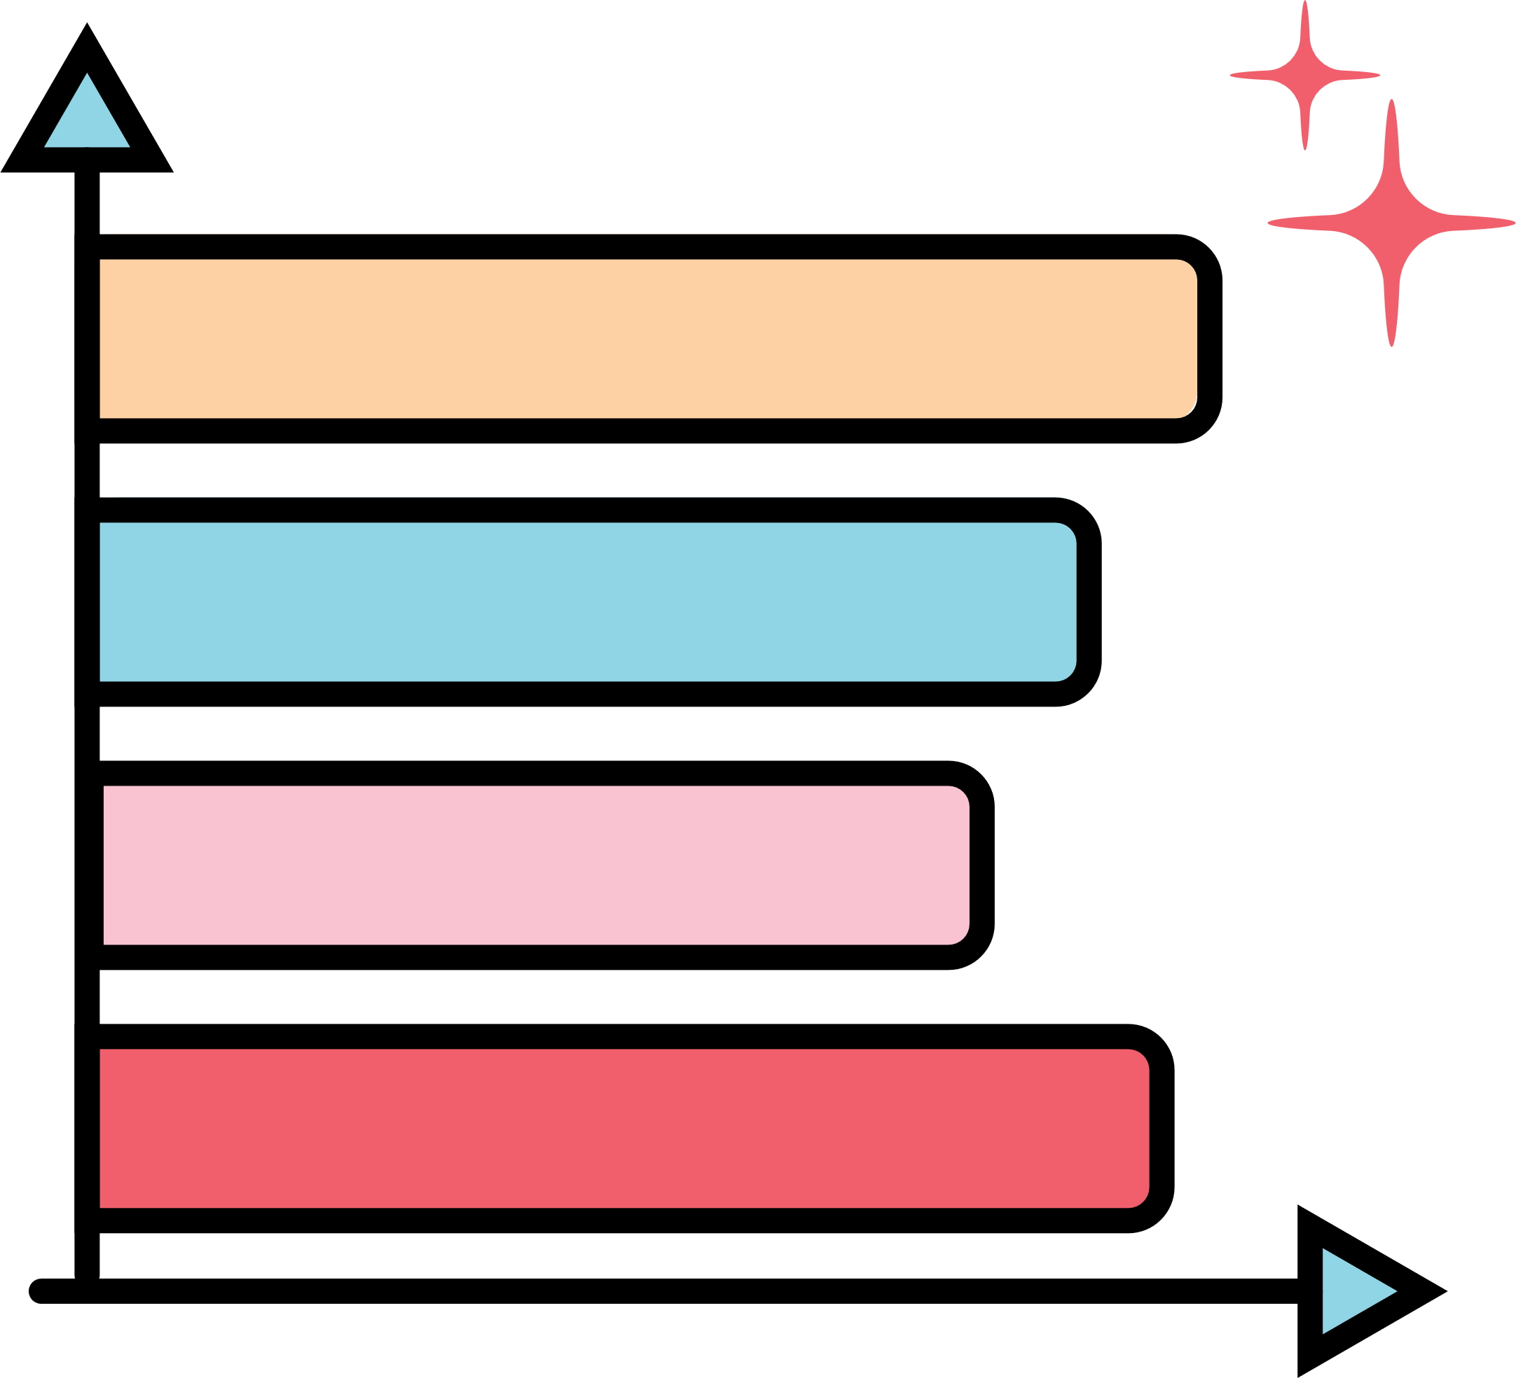


DATA SETS USED:
The dataset used in this project is sourced from Open Canada. The data was cleaned to show the Province/State, Fraud and Cybercrime Thematic Categories, Solicitation Method, Gender, Victim Age Range, and Dollar Loss in terms of fraudulent transactions.

Slide 4
Flow Chart
Data Source (Credit Card Data)
Data Processing & Cleaning
Data Storage
PostgreSQL
Data Analysis
Python, Pandas
User Interface
Webpage, Script, Flask
Data Visuals
Bar Charts, Pie Charts, Heat Map
User Interpretation & Analysis

Slide 5






Data Analysis Process:
Data Collection
Data Consolidation and Analysis
Data Visualization

Slide 6

Data Storage & Analysis
The cleaned dataset is stored in an SQL database:
Ensures easy access and manipulation.
Provides a secure and structured storage solution.
Further analysis in Python:
Utilized for calculating percentages and correlations.
Unveiled deeper insights and answered key questions.

Slide 7
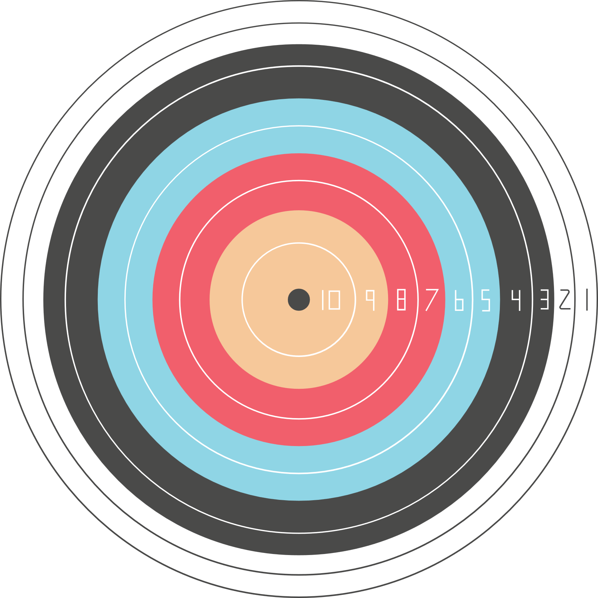

STATISTICS
Let’s jump into the statistics of the data we found.

Slide 8
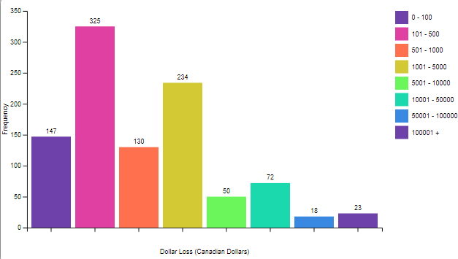

Frequency of Fraudulent Loss Amount

Slide 9
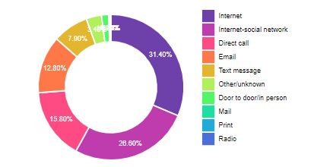

Insights
Top 5 categories:
Internet - 31.4%
Internet-social network - 26.6%
Direct call - 15.8%
Email - 12.8%
Text message - 7.9%
description

Slide 10
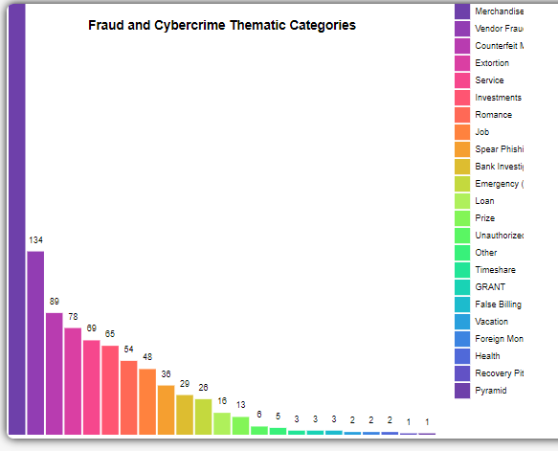

Most noticeable fraud crimes happen in merchandising occuring about 314 times.
That’s one third of our data!

Slide 11
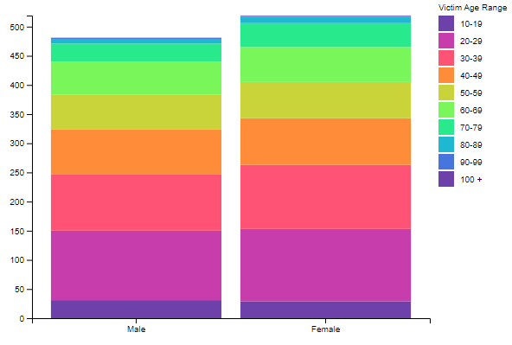

Targeting Ranges:
20s - 30s (most targeted)
30-50s (next targeted)
60+ (least targeted)

Slide 12

ARE THERE ANY QUESTIONS?
That concludes this presentation

